Slide 1



TRANSMISSION LINE FAULT DETECTION SYSTEM
DEPARTMENT OF ELECTRONICS AND COMMUNICATION ENGINEERING
FINAL REVIEW
PRESENTED BY :
Sandheep.S (927621bec171)
Santosh kumar.S (927621bec182)
Sangeeth kumar.R (927621bec173)
GUIDE :
Dr.A.Maheshwari
[ASSISTANT PROFESSOR]

Slide 2
Introduction
A transmission line system is a network of electrical highways that transports electricity from power plants to homes and businesses. It's like a delivery system for power, ensuring that electricity generated in one place can reach distant locations.
These lines act as power conduits, allowing energy to flow efficiently across long distances. Much like a giant extension cord, transmission lines carry the electricity to where it's needed most, keeping our lights on and devices powered.
With towers and cables, these lines crisscross the landscape, silently working to provide the energy that fuels our everyday activities. In essence, transmission lines are the vital links that make sure electricity travels smoothly to every corner of our communities.

Slide 3
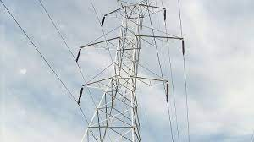
Transmission line
In electrical engineering, a transmission line is a specialized cable or other structure designed to conduct electromagnetic waves in a contained manner.
The term applies when the conductors are long enough that the wave nature of the transmission must be taken into account.

Slide 4
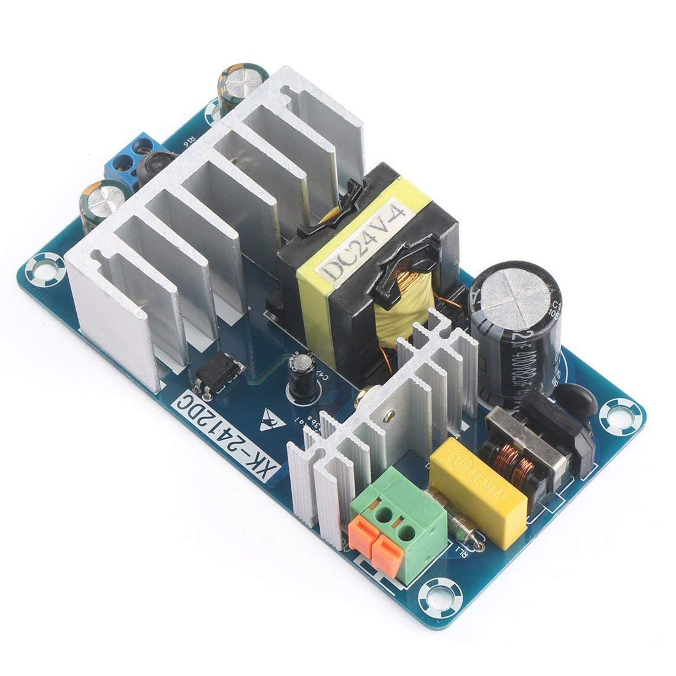
AC to DC Convertor
An AC to DC converter transforms alternating current (AC) into direct current (DC). It rectifies and filters the AC input to produce a steady DC output. This conversion is vital for powering electronic devices and equipment that operate on DC power.
Various types of converters exist, including half-wave and full-wave rectifiers.
They play a crucial role in enabling the compatibility and efficient utilization of electrical energy across diverse applications.

Slide 5
Objectives
Our aim is to establish a robust fault detection system for swiftly identifying and responding to transmission line faults like fire breakdowns and short circuits.
By promptly detecting faults induced by high voltages and initiating an immediate shutdown, we prioritize safety and prevent power loss.
Integrating sensors on transmission line poles ensures a proactive approach in minimizing fire incidents, ultimately improving network reliability and safety.

Slide 6
Abstract
The fault occurred in transmission line is very much dangerous for the locality.
In HV and EHV transmission line there are less fault occurrence but in locality the fault occurrence is more as compared to outer transmission line.
In our prototype we design a model which is to be detect the fault in transmission line by comparing the voltage signal between the transmission line and a reference value, the reference value is predetermined and if the transmission line voltage is more than or less than reference value then fault is to be shown in display.

Slide 7
Existing Method
The electric power grid is highly vulnerable to a variety of natural actions, which can have a considerable effect on power system operation.
A faulted segment can be determined from audible or electromagnetic signals and requires dispatching crew members to the outage area. There have been various techniques largely used in the industries, including the tracing approach through acoustic, electromagnetic or current.
It is a technique used to detect fault location of cable from one or both ends without tracing.

Slide 8
Problem Statement
There is lack of fault detection systems in some rural areas.
High initial cost.
The only work that addresses the problem of finding optimal locations of faults in the transmission lines.
This problem is to come up with a mechanism that can detect the fault in electricity transmission line automatically and intimate the authorities with a specific location.

Slide 9
Proposed Method
In our proposed method, when there is any fault in the transmission line due fire breakdown in the line connections, when any line is grounded and any over lap or short circuit in the transmission line then the detector detects and the power is off.
Fire break down is due to the high voltages in the transmission line which results in high temperature and outcome is fire and fault is detected by the sensor fixed in the poles.
when the phase wire or any wire is grounded the power loss is detected and this results in avoiding the power loss.

Slide 10
Components Used
Duel Channel Relay Module
AC to DC Convertor
Jumper wires
Flame Sensor
Transmission wires
Bulbs

Slide 11
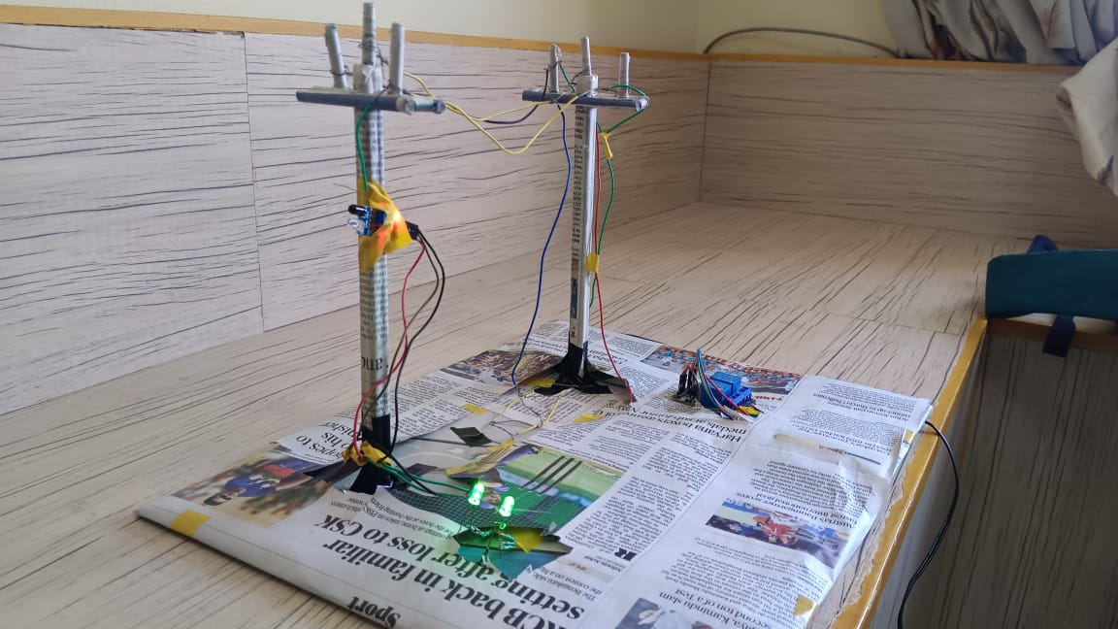
Output

Slide 12
Conclusion
The model design in such a way to solve the problems faced by consumer.
By using such method, we can easily detect the fault and resolve it.
It is highly reliable and locate the fault in three phase transmission line and also supposed to data storage.

Slide 13
Reference
[1] G. Vidhya Krishnan, R.Nagarajan, T. Durka,M.Kalaiselvi, M.Pushpa and S. Shanmuga priya, "Vehicle Communication System Using LiFi Technology," International Journal of Engineering and Computer Science (IJECS), Volume 6, Issue 3, pp. 20651-20657, March 2017.
[2] J. Chandramohan, R. Nagarajan, K. Satheeshkumar, N. Ajith kumar, P. A. Gopinath and S.Ranjith kumar,"Intelligent Smart Home Automation and Security System Using Arduino and Wi-Fi," International Journal of Engineering And Computer Science (IJECS), Volume 6, Issue 3, pp. 20694-20698, March 2017.
[3] V. C. Gungor and F. C. Lambert, “A survey on communication net-works for electric system automation,” Comput. Netw. vol. 50, no.7, pp.877– 897, May 2006.
[4] P. Ramachandran, V. Vittal, and G. T. Heydt, “Mechanical state estimation for overhead transmission lines with level spans,” IEEE Trans. Power Syst., vol. 23, no. 3, pp. 908– 915, Aug. 2008.

